Slide 1
ITOM 2308
Introduction to Databases
Review Access Database
Corporate Case Study

Slide 2
Why Build a Database
Share data
Control redundancy
Consistence
Increase productivity
Improve productivity

Slide 3
Size of DB’s
Small: Single user
Word, Excel
Medium: Small community of users < 10
Access, Paradox, FileMaker Pro
Large: Enterprise wide large community of users >10
SQL Server, Oracle, DB2 (IBM)

Slide 4
Platform Factors
Who:
Owns the database
Uses the database
Updates the database data
Periodic updates:
Daily
Weekly
Monthly

Slide 5
Types of Databases
Flat File
Relational
Cube (OLAP)
In-memory database

Slide 6
DB Building Blocks
Entities:
Collection of like items
Noun (Person, place, or thing)
Examples: Books, Authors, Stores

Slide 7
DB Building Blocks
Attributes:
Property of an entity
Examples:
Books: Title, Authors, Publisher
Authors: Name, Address, Phone
Stores: Market/Division, Address, Phone

Slide 8
DB Building Blocks
Relationships:
Association between entities
Examples:
One-To-Many
A Book has one Publisher
A Publisher has many Books
Many-to-Many
An Author has many Books
A Book has many Authors

Slide 9
DB Definition
A database is a structure that can store:
Information about multiple types of entities
The attributes of these entities
Relationships among these entities

Slide 10
Advantages Disadvantages
Share Data
Constancy
Integrity
Control redundancy
Processing time
Single container
Size: Disk/memory
Complexity: How tables are joined
Greater impact of failure
Recovery more difficult

Slide 11
Relational Databases
A series of tables
Linked together by relationships
Ultimate challenge
How to set up the tables
Develop the data dictionary

Slide 12
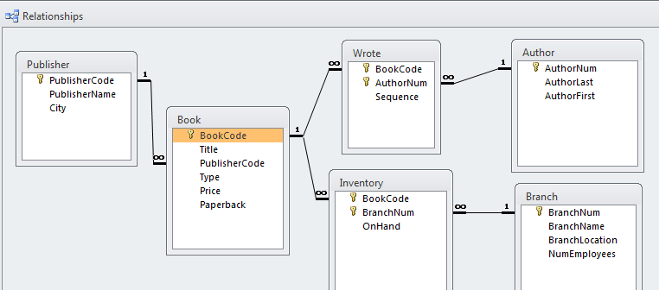
Relationship Graphical View

Slide 13
Database Programs What is Needed
Method for
Storing data
Data Input
Extract data

Slide 14
Components
Input Storage Output
programs (DB) programs

Slide 15
Examples
Input | Databases | Output
Custom Programs | Oracle | Other Databases
Web/Internet | IBM DB2 | Excel
Other Databases | MS SQL Server | Custom Programs
Excel/Word | MS Access | Web/Internet

Slide 16
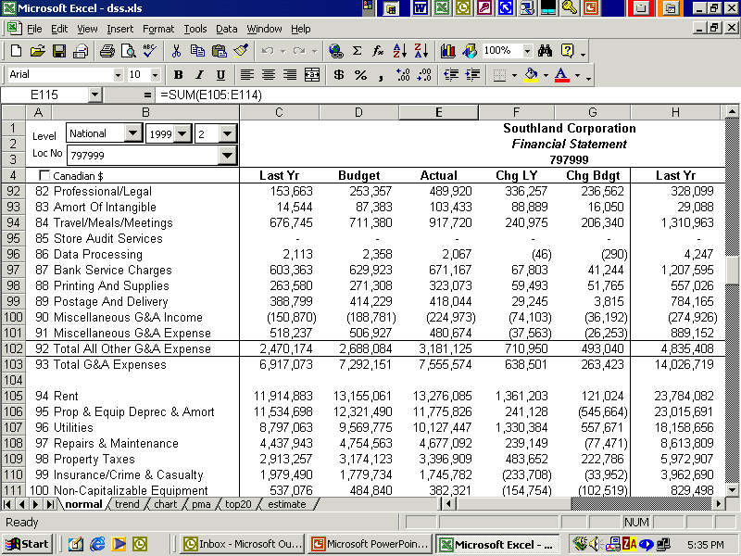
Multi Database View
Sales
Data
Mart
Financial

Slide 17
Microsoft Access
MS Office database (DB) tool
Can only have one DB open at a time
Create the file name on start of file
Can not use save as, must copy from file system

Slide 18
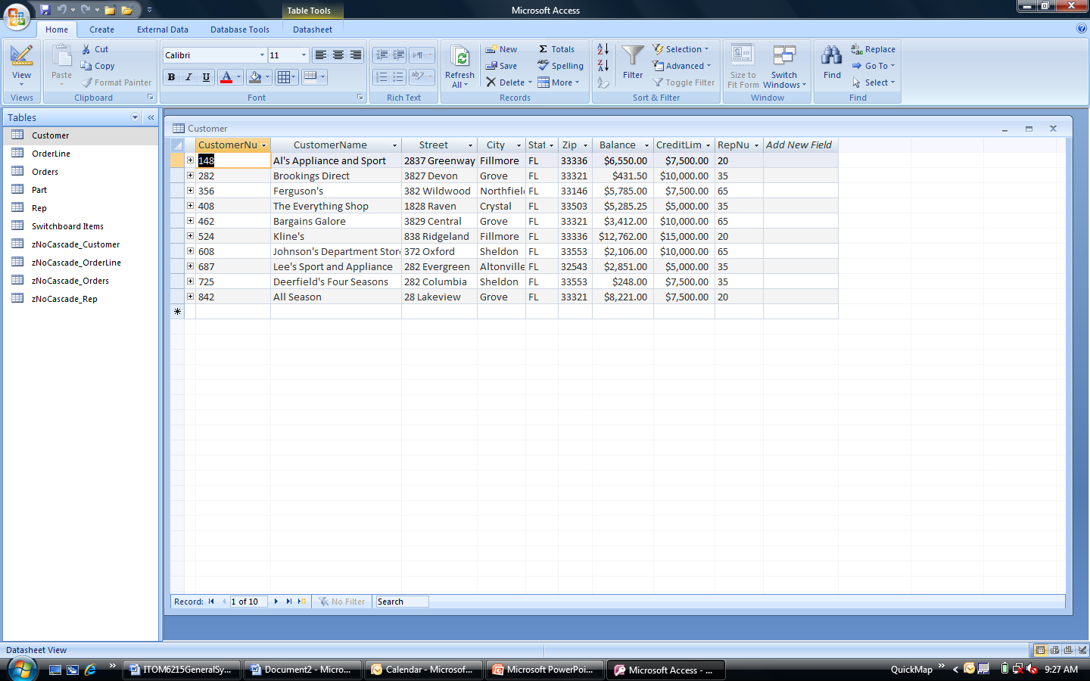
Microsoft Access Program

Slide 19
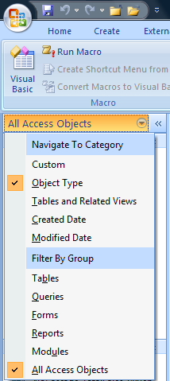
Access Objects
Tables
Queries
Forms
Reports
Modules (Macros and VBA)

Slide 20
Access Tables
Can have many tables
Used to store data
Tables have fields
Fields are made up of:
Name (can’t duplicate)
Field Types
Keys and Indexes

Slide 21
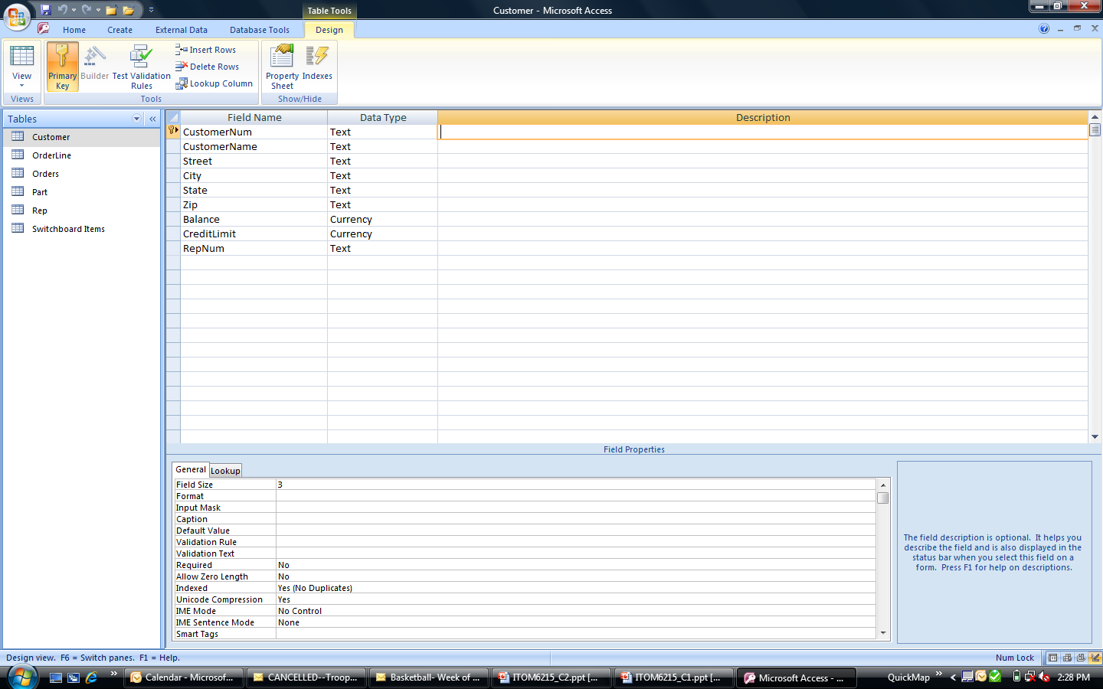
Table Design View
Collection of fields

Slide 22
Table Design View
Field level detail

Slide 23
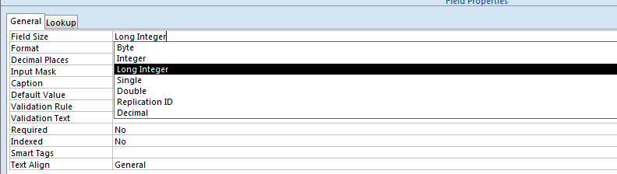
Table Field Types
AutoNumber: Increments on new record
Number: Integer/ Long Int/ Double
100 / 500,000 12.50

Slide 24
Table Field Types
Text: 255 Characters or less
Memo: > 255 characters (Poor for searching)
Date/Time:
Yes/No: Boolean, true/false

Slide 25
Forms
Used to input data
Used to display data
Can have:
Multiple forms on a screen
Data validation across fields
Calculations
VBA Code

Slide 26
Reports
Used to display data
Banded style reporting
Can have vba code behind
Source is a Table/Query

Slide 27
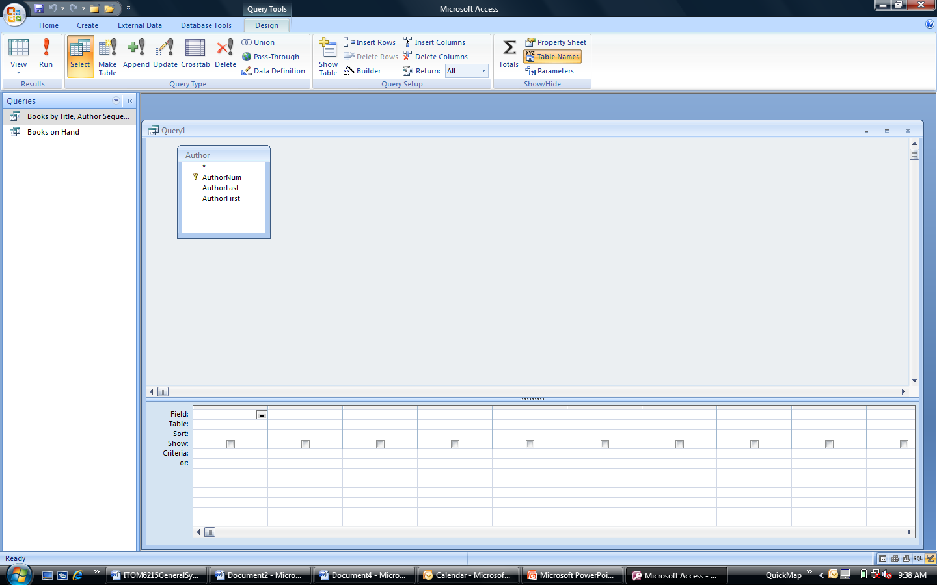
Queries
View of the data
Update/Replace the data
Add new records
Delete new records
Make a new table

Slide 28
Case Study ExxonMobil Asset Disposition
Trammel Crow Corporate Services (TCCS)
650 Pads sites
$850,000,000 valuation
Data intensive project

Slide 29
Initial Findings
6 Employees were selling 10 sites a year
No sales compensation
List of properties stored in a Wang word processing file
Motivation was extremely low
Corporate policies
Environmental issues

Slide 30
TCCS Goals
Turn closed gas station pad sites into cash
Meet certain sales milestones over time
Prove to the business community that outsourcing was worth the money
Find another whale (McDonald’s)

Slide 31
Data Problems
Sorting properties was difficult
By city, state
By size (square feet, frontage)
Reporting on sales cycle was non-existent
Appraise, price, offers, environmental, sales
Historic tracking activities were missing

Slide 32
Building a Database
Meet with sales team to determine sales cycle monitoring
What data is needed to track sales
Who will update data

Slide 33
Building a Database cont.
Meet with management team and client to determine reporting needs
TCCS internal reporting
TCCS external reporting
Exxon internal reporting
Exporting data to Exxon accounting systems

Slide 34
ExxonMobil Solution
Built a Paradox database (DOS)
About 15 tables
Security set up by LAN
20 Reports
Executive and Client reporting
Used Excel from extracted data

